Slide 1

Popularity-Aware Topic Model for Social Graphs
Junghoo “John” Cho
cho@cs.ucla.edu
UCLA

Slide 2
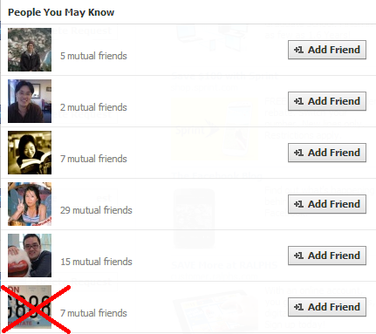
Grouping Users
Facebook friend recommendation

Slide 3
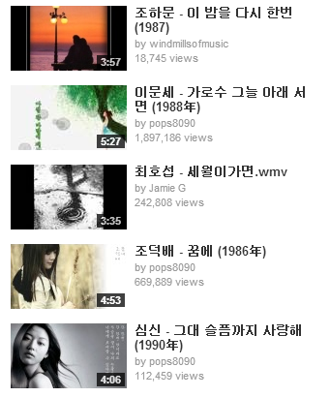
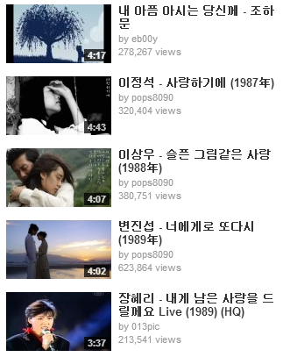
Grouping Music
Youtube “similar to” 이 밤을 다시 한번

Slide 4
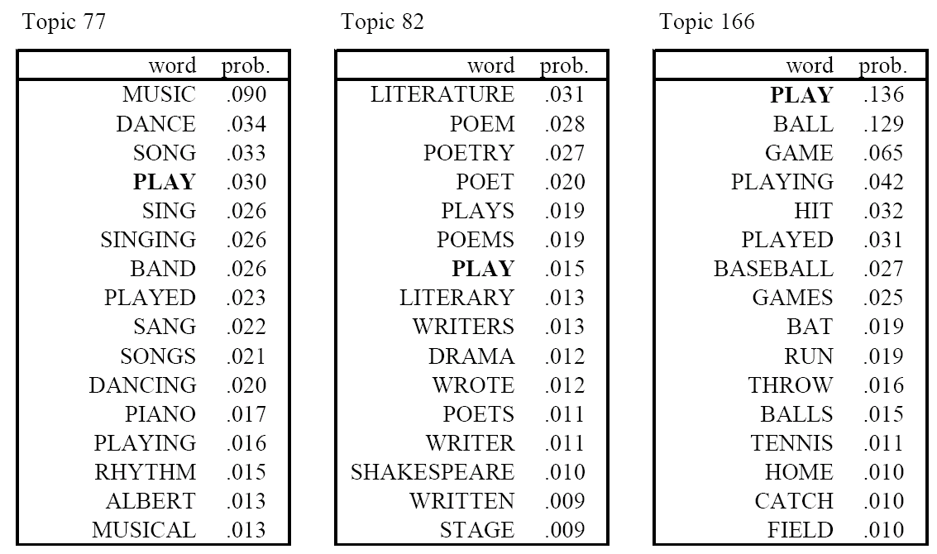
Grouping Words
Topic-based word clustering
Results from 37,000 passages of TASA corpus

Slide 5
Core Issue
How can we group “objects” that are similar to each other?
Probabilistic topic model has been very effective for this task in textual data
Particularly, Latent Dirichlet Analysis (LDA)

Slide 6
Topic Models for Graphs
Can we use LDA for data from other domains?
Graph representation of data
“Cluster” nodes in a graph by their topics
Any problem?
Docs
Words
Users
Users
Movies
Contains
Follows
Watches
doc₁
money
barack
obama
alice
Love
Actually
doc₂
bank
hugh
grant
bob
Twilight
doc₃
river
robert
pattinson
eve
Batman

Slide 7
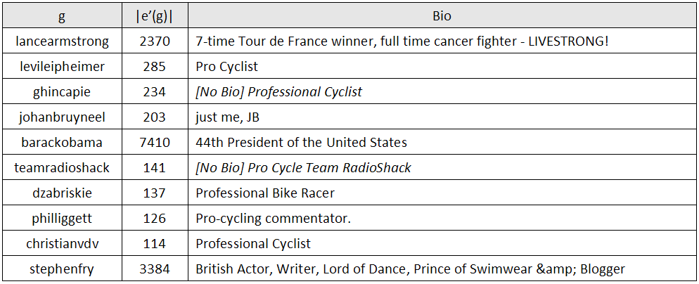
Curse of “Popularity Noise”
Example result
LDA is applied to the Twitter follow graph

Slide 8
Curse of “Popularity Noise”
LDA requires that all words appear roughly at the same frequency
“Solution”: Remove too frequent or too infrequent words
This “hack” works fine for textual data because too frequent words are function words without much meaning
But in data from other domains
Frequent items are often items of interest in other domains
Cannot simply remove frequent items from data

Slide 9
Overview
Introduction to LDA
Document generation model
LDA inference
Introduction to popularity-aware topic model
Popularity path
Inference
Experimental results

Slide 10

Document Generation Model
How do we write a document?
Pick a topic
Write words related to the topic
?

Slide 11
Probabilistic Topic Model
There exists T number of topics
For each topic, decide the words that are more likely to be used given the topic.
Topic to word vector P(w_{j}|z_{i})
Then for every document d,
The user decides the topics to write on
Document to topic probability vector P(z_{i}|d)
For each word in d
The user selects a topic z_{i} with probability P(z_{i}|d)
The user selects a word w_{j} with probability P(w_{j}|z_{i})

Slide 12
Probabilistic Document Model
P(w|z)
P(z|d)
1.0
money
1
bank
1
loan
1
loan
DOC 1
money
bank¹ money^{1 …}
bank
0.5
Topic 1
money¹ river² bank¹ stream² bank² ...
DOC 2
0.5
river
stream
1.0
river² stream² river² bank² stream² ...
DOC 3
bank
Topic 2

Slide 13
Plate Notation of LDA
α
P(z|d)
z
β
w
P(w|z)
M
T
N
Often, α = 50/T, β = 200/W

Slide 14
How Is the Model Used for the Task?
Given the document corpus, identify the hidden parameters of the document generation model that “fits” best with the corpus
Model-based inferencing

Slide 15
Generative Model vs Inference (1)
P(w|z)
P(z|d)
1.0
money¹ bank¹ loan¹ bank¹ money¹ ...
loan
DOC 1
money
bank
0.5
Topic 1
money¹ river² bank¹ stream² bank² ...
DOC 2
0.5
river
stream
1.0
river² stream² river² bank² stream² ...
DOC 3
bank
Topic 2

Slide 16
Generative Model vs Inference (2)
?
money? bank? loan? bank? money? ...
?
DOC 1
?
?
?
Topic 1
money? river? bank? stream? bank? ...
DOC 2
?
?
?
?
river? stream? river? bank? stream? ...
DOC 3
?
Topic 2

Slide 17
Addressing Popularity Noise
How to eliminate noise from popular nodes?
Many models tried: multiplication model, polya-urn model, two-path model, …
Why does a Twitter user follow Justin Bieber?
Because the user is interested in pop music
Because Justin Bieber is a celebrity
“Two-path” for following other users
Popularity path (because the user is “popular”)
Topic path (because of the interest in the user’s topic)

Slide 18
Plate Notation
γ
α
N
P(z|d)
P(p|d)
M
z
p
β
w
π
η
P(w|z)
T

Slide 19
Model Inferencing by Gibbs Sampling

Slide 20
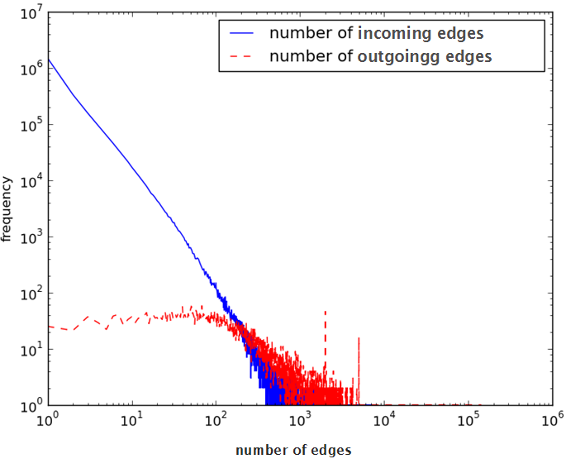
Twitter Dataset
10 million edges from the Twitter user follow graph (crawled in 2010)
Non-popular writer group
(Edges to non-popular writers)
Popular writer group
(Edges to popular writers)

Slide 21
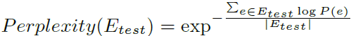
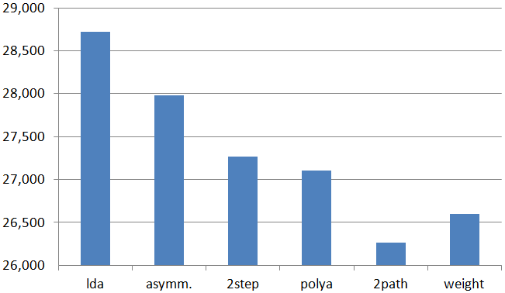
Perplexity
How well does “new” data fit with the model?
Lower is better

Slide 22
Survey
“Coherence” of 23 random topic groups were evaluated by 14 participants
Relevant
Relevant
Relevant
Relevant
Irrelevant
Relevant
Relevant
Relevant
Relevant
Irrelevant
# of followers
8 true positives
2 false positives

Slide 23
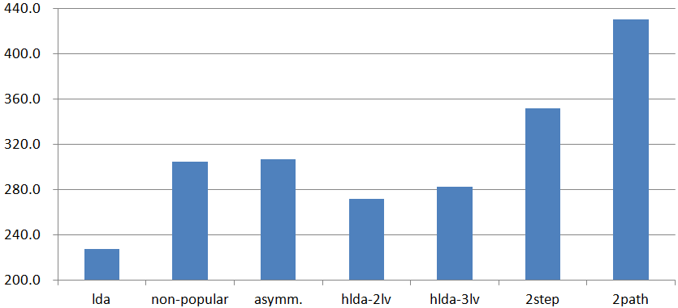
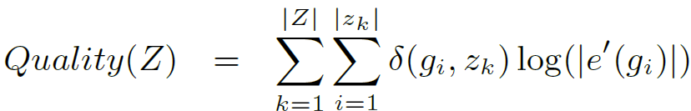
Quality
Human perceived quality of each topic group from survey results
true/false positive
weight

Slide 24
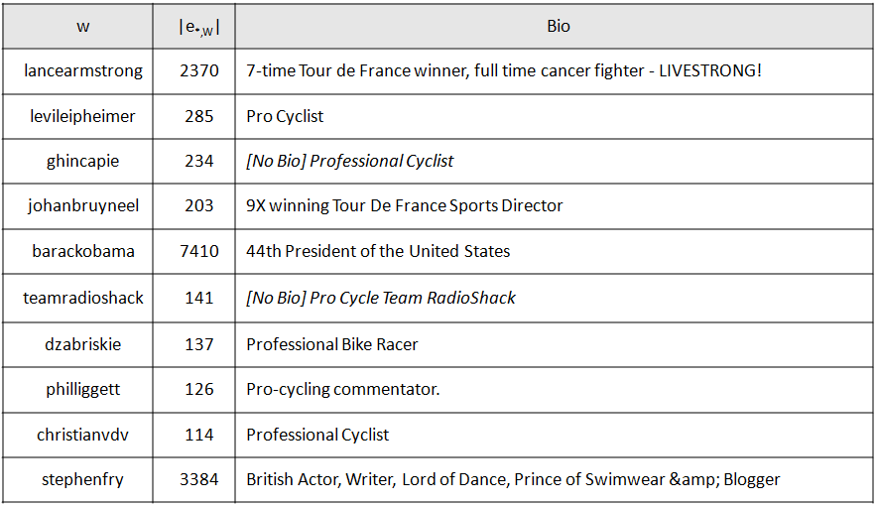
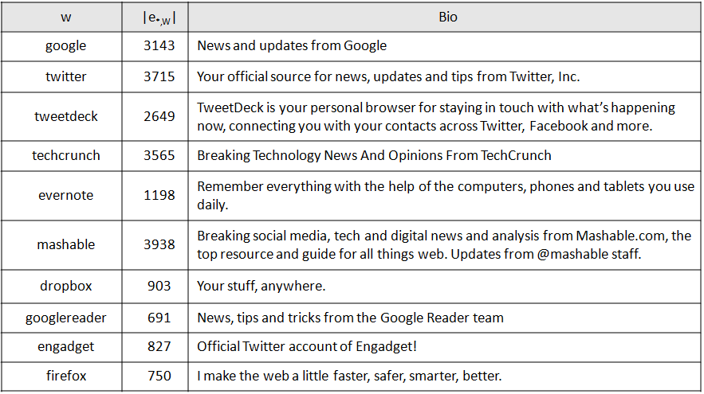
Example Topic Groups
Popular and related users in each group

Slide 25
Conclusion
Popularity-bias problem in graphs
Popularity-aware topic models
2-path model
Experiments on Twitter dataset
Low perplexity
High quality

Slide 26

Thank You
Any questions?

